Slide 1
Management
PhD in Business Economics
Luis D. Torres, PhD.

Slide 2
Agenda and Objective
Unit 1: The Organisational Theory Landscape: Mapping the field
The evolution of organization theory
Efficiency and rationality in organizations
The session focuses on evaluating organisational theory perspectives critically and understanding the evolution of the field

Slide 3
Introduction
Organizational theory
Management theory
What is a theory?
What is management and organizational theory?

Slide 4
Using theory
To build a strong doctoral thesis, you must move beyond describing data and start explaining underlying mechanisms:
Use of references:
Mistake: Listing authors without explaining the internal logic
The right way: You must explain why the cited work supports your specific argument.
Use of data:
Mistake: Using empirical findings or "what happened" as an explanation for why it happened.
The right way: Data describes patterns; theory explains the causal reasons for those patterns.
Use of variables:
Mistake: Defining independent and dependent variables and assuming the list explains the relationship
The right way: You must explain the process by which Variable A leads to Variable B.
Use of hypothesis:
Mistake: Presenting a list of predictions (Hypothesis 1, 2, 3) without the "connective tissue“
The right way: Hypotheses are the conclusions of a theoretical argument, not the argument itself.

Slide 5

The evolution of management theory
Classical School (Late 19th - Early 20th Century):
Scientific Management (Taylorism): Focused on maximising efficiency, finding the "the one best way" to perform a task, and labour productivity.
Administrative Management (Fayol): Focused on the formal structure of the organisation and the universal functions of management (planning, organising, commanding, coordinating, controlling).
Bureaucratic Management (Weber): Emphasised hierarchy, clear division of labour, and formal rules to ensure rationality.
What does these theories allow you to see clearly, and what does it force you to ignore?

Slide 6
The evolution of management theory
Theory | Focus | The omission | Modern Implication
Scientific Management | Task Efficiency | Human Psychology/Well-being | Algorithmic management (Uber/Amazon).
Administrative | Universal Principles | Local Culture/Context | Global vs. Local management tensions.
Bureaucracy | Rational Rules | Flexibility/Innovation | Difficulty in "Wicked Problem" solving.

Slide 7
The evolution of management theory
Behavioural School (1920s - 1950s):
Human Relations: Initiated by the Hawthorne Studies, shifting focus from mechanical efficiency to human relations, group dynamics, and employee motivation.
Western Electric accidentally discovered that workers are not just motivated by money (Classical view) but by being observed and belonging to a group.
Scientific Management treated workers as interchangeable parts, the Behavioural school treats them as social beings.
Classical theory focuses on the formal org chart. Behavioural theory focuses on the informal group dynamics.
What do you think: Behavioural school sometimes omits the reality of power and conflict in organisation by assuming everyone can be happy if they just feel included.

Slide 8
The evolution of management theory
Quantitative School (Post-WWII):
Introduced mathematical modelling, statistics, and computer simulations to optimise organizational decision-making
Systems & Contingency Theories (1960s - 1970s):
Systems Theory: Views the organization as a set of interrelated parts that interact with an external environment.
Contingency Theory: Argues there is no "one best way" to manage; the most effective approach depends on the specific situation or "contingency".
Contemporary & Global Era (1980s - Present):
Focuses on Total Quality Management (TQM), the Learning Organisation, and managing in a globalized, hyper-competitive landscape

Slide 9
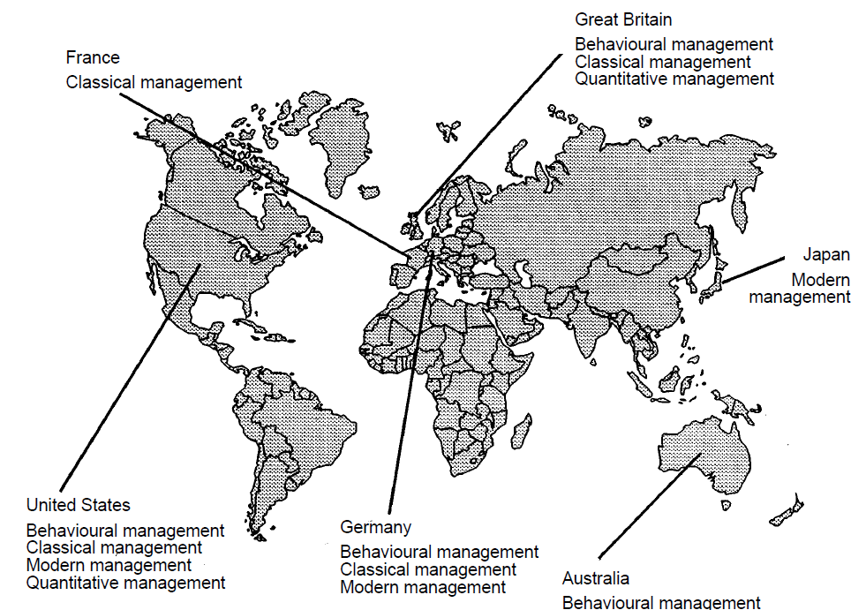
The evolution of management theory
Modern management continue to evolve by integrating theories
Older approaches have become embedded in more contemporary forms of management

Slide 10
The evolution of management theory
Why, after 80 years of formal study, do we still lack a unified theory of management?
Does the current lack of integration in the field provide an opportunity for your PhD thesis, or is it a barrier?

Slide 11
Be careful
Management progress isn't always linear or strictly "scientific." Instead, it is a "fashion industry" where consultants, business schools, and gurus co-create "innovative" techniques to satisfy a demand for progress
Identify a "fashionable" concept typically used today by organisations
Discuss how these concepts gain legitimacy. Is it because they are empirically proven to work (rationality), or because they "look" modern and progressive (rhetoric)?

Slide 12
Be careful
But this is not the only challenge in management theory (and other fields too).
Concept | Key Driver | Main Criticism | Research Caution
Management fashion | Demand for Progress and Novelty. | Short-lived; often lacks deep empirical grounding. | Avoid "buzzword" research; look for the enduring theory underneath.
Rationality myth | The need for organisations to appear efficient. | Efficiency is often a performance for stakeholders, not a reality. | Question if the "efficiency" you are measuring is real or symbolic.
Theoretical omissions | Disciplinary boundaries (Sociology vs. Economics). | You cannot see what your theory doesn't have a word for. | Always state your theoretical assumptions and what they "omit."

Slide 13
As a PhD researcher, how do you ensure your theoretical framework isn't just a 'fashionable' lens that makes you blind to the most critical aspects of your research problem?

Slide 14
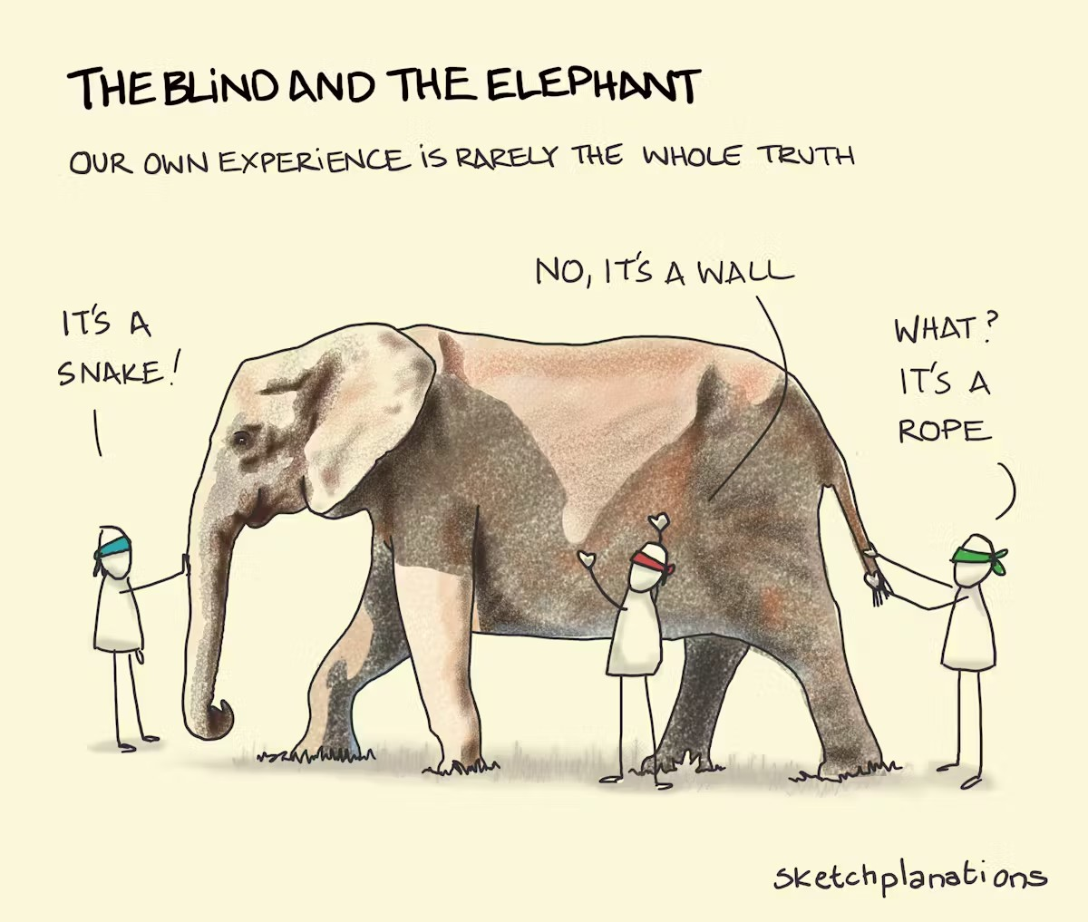
Summary

